Slide 1
Algorithms and Data Structures (CIS1002-N)
Week 4: Linked-List Implementation and ICA Briefing
Module Leader: Dr Annalisa Occhipinti
Email: A.Occhipinti@tees.ac.uk

Slide 2
Schedule
Week | Lecture (1hour) – Lab Session (2hours)
Week 1 | Introduction to Algorithms and their related Data-Structures – Array ADT
Week 2 | Sorting : Bubble sort, Cocktail Shaker sort | ICA Briefing
Week 3 | Sorting : Selection sort and Insertion sort
Week 4 | Singular Linked-lists | ICA Briefing – Programming Tasks
Week 5 | Doubly Linked-lists
Week 6 | Circular Linked-lists
Week 7 | Stacks
Week 8 | Queues
Week 9 | Recursion
Week 10 | Recursion
Week 11 | Trees and balanced trees
Week 12 | Merge Sort and Quick Sort
Note: The schedule may be adjusted based on class progress.

Slide 3
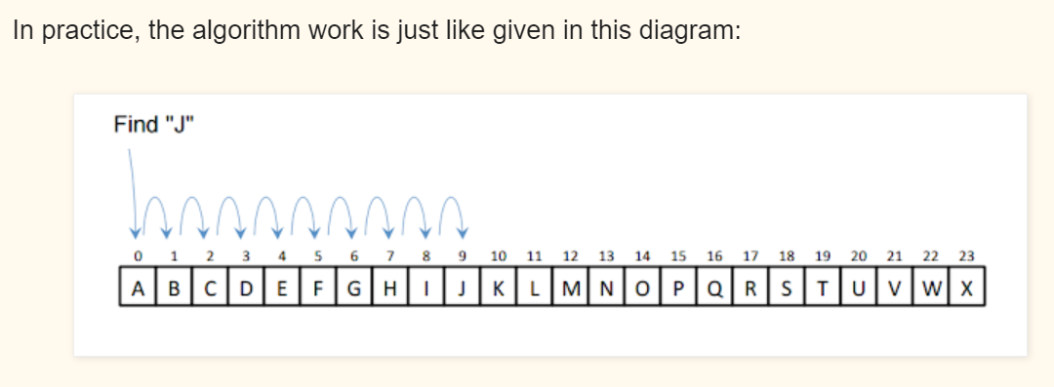
Homework
Implement the Linear search Algorithm in Java.
You should go through all elements in the array using a for loop and compare each element with the one you want to search. when an element matches you return true/false.
Use the method signature below:
linearSearch(int[] a, int obj) // a is the array and obj is the elements that you want to search.

Slide 4
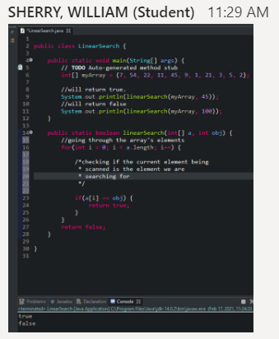
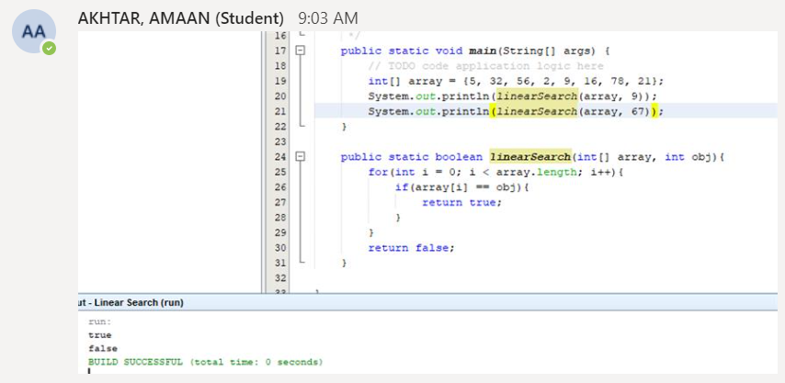
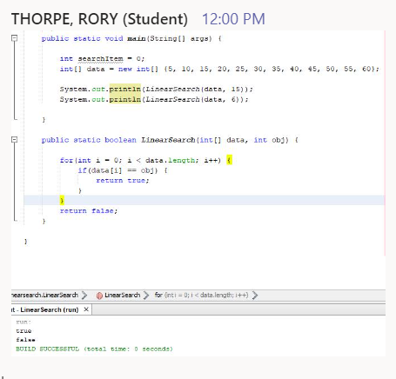

Slide 5
Answer
public static boolean linearSearch(int[] a, int obj) {
for (int i = 0; i < a.length; i++) {
if (a[i] == obj) {
return true;
}
}
return false;
}
}

Slide 6
Today…
Implementation of Linked-lists (Concrete DT)
ICA Briefing

Slide 7
Linked-Lists (recap)
Definition:
Collection of components, called nodes.
Each node in a linked-list has 2 components:
1 to store the relevant information: data
1 to store the address of the next node: next
Each node (except the last node) contains the address of the next node.
head
data
next
data
next
data
next
data
next
data
null

Slide 8
Linked-Lists (recap)
Methods so far:
Insert(node e) Inserting a new node
Delete(node e) Deleting a new node
head
data
next
data
next
data
next
data
next
data
null

Slide 9
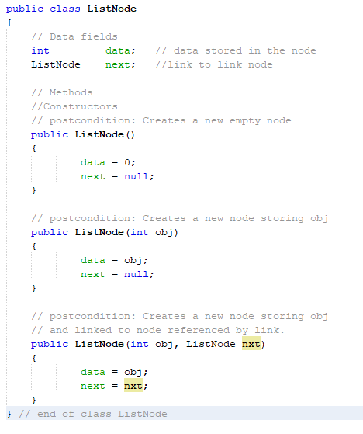
First step: creating the ListNode class

Slide 10
Let’s play with this class…
Use the main class to create two nodes and connect them to create a list
Print the first element of the list.
Print the second element of the list
Add another element to the list and print it….
This is a bit complicated, isn’t it?

Slide 11
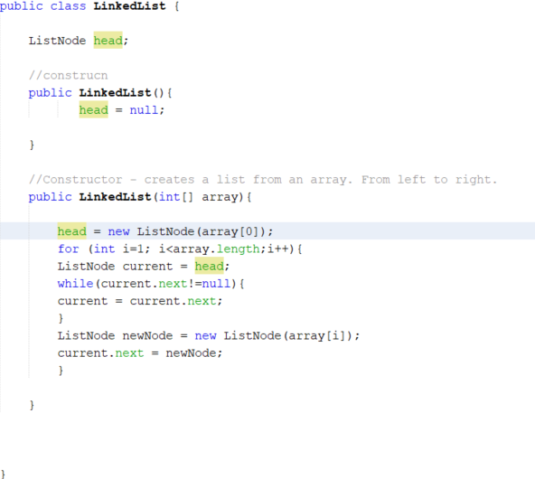
Second Step: LinkedList class (left to right)

Slide 12
Third Step: Let’s add some methods
Use the main class to create a new empty list
Add a method to insert a new node
void addFirst(int entry)
Use this method to add 4 nodes in the list
void printList()
int getSize()
String listToString() – return a description of the content of the list in the form {1, 5, 7, 9}

Slide 13
LinkedList from a array

Slide 14
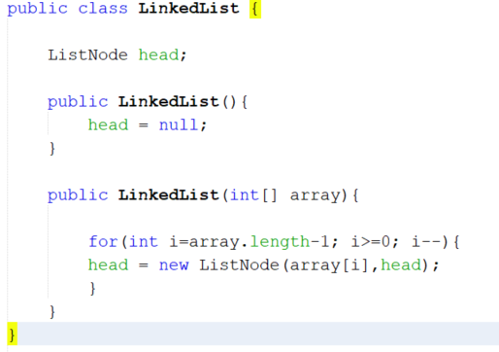
LinkedList from array (a more elegant solution…)

Slide 15

Write the code for the methods below
int getFirst(): return the data value of the first item
int getLast(): return the data value of the last item
int getAtPosition(int index): return the data value of the item at position index
What if the list is empty?

Slide 16
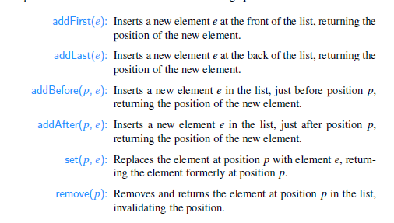
The basic methods of any linked-lists

Slide 17
Exercise
Implement the method below for the LinkedList class
int getLast(): return the data value of the last item
You could start by drawing a diagram.

Slide 18
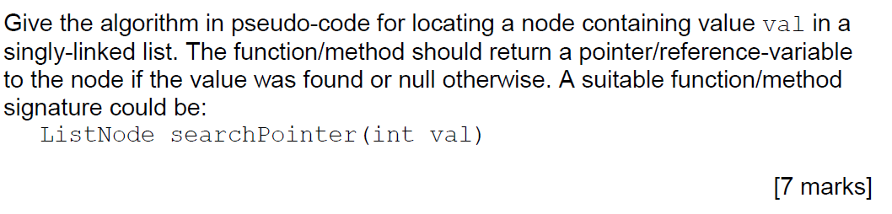
Exam Question. Search for a value

Slide 19
Quiz on BB – Week 4

Slide 20
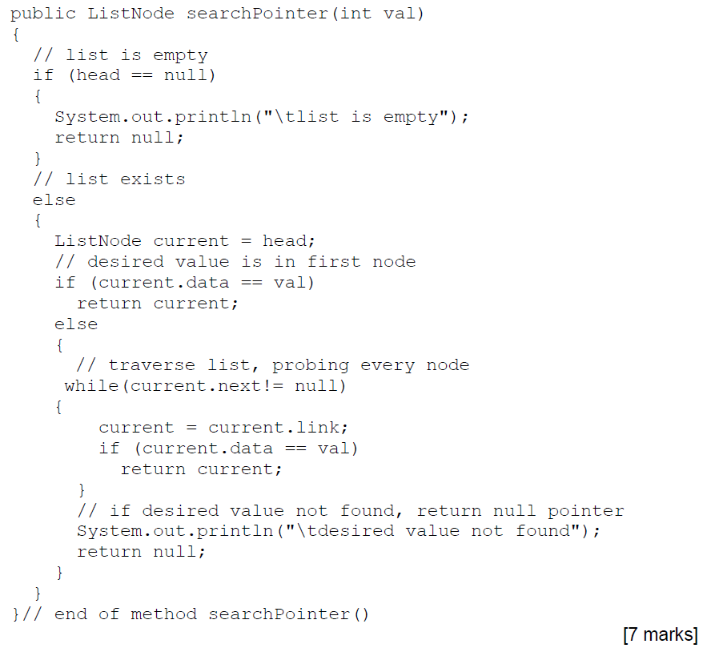
This is just one possible answer.
Make sure you add comments in your code.

Slide 21
Homework: Interview Question
Write a Java algorithm for reversing a singly linked list, you cannot use extra space.
Public void reverseList(){
}
Hint: Use three pointers: previous, current and next to go through the list.
Example:
Input:
Output:
head
5
next
10
next
25
next
13
next
8
null
head
8
next
13
next
25
next
10
next
5
null

Slide 22
ICA Briefing

Slide 23
ICA - Briefing
Component One (80%) will take the form of a programming task. Students will be assessed for the quality of their implementations with respect to the representation and operations of data structures.
You will be provided with a zip folder with the classes you need to use and some unit tests to test your methods.
Component Two (20%) will take the form of an end Quiz. This assessment will require students to identify and select appropriate data structures to solve a given problem. The quiz will test the students’ understanding of the modules’ topics in the wider context of Computer Science. This quiz will take place in May

Slide 24
Check the ICA Document for the methods to implement
Under Assessment on Blackboard…

Slide 25
Unit Tests
If you’ll get 100% in the Unit Tests, this DOES NOT mean that you’ll get 100% in the first part of the ICA. We are providing only SOME of the unit tests we will be running to mark your assessment.

Slide 26
Homework: Exam Question. Search for a value
Share your solution on the Team page!

Slide 27
Homework: Interview Question
Write a Java algorithm for reversing a singly linked list, you cannot use extra space.
Public void reverseList(){
}
Hint: Use three pointers: previous, current and next to go through the list.
Example:
Input:
Output:
head
5
next
10
next
25
next
13
next
8
null
head
8
next
13
next
25
next
10
next
5
null

Slide 28
